Slide 1


Machine learning model detecting fraud in insurance claims

Slide 2
Table of Contents
01
03
02
04
Problem Statement & Solution
Business Model
Business Model Canvas (BMC)
Conclusion

Slide 3
Problem Statement & Solution
01

Slide 4

Fraud occurs but can’t detect some cases
e.g.
John is a customer who has recently filed a claim with his auto insurance company after his car was involved in an accident
1. The accident report contains inconsistent information :
The time and location of the accident are different in the police report and the hospital records.
Has pre-existing injury in the same location as the one he claims to have sustained in the accident
2. Has recently experienced financial difficulties and has a history of bankruptcy and other financial problems.
Negative impact :
Financial Losses
Customer Dissatisfaction
Face regulatory penalties or sanctions for failing to prevent or report fraudulent activities.

Slide 5

Solution
Build the model detecting fraud in insurance claims with high efficiency

Slide 6
Why use the model detecting fraud?
Improve customer
service
Improve customer
service
Faster Detection
Reduce Costs
More Precise

Slide 7
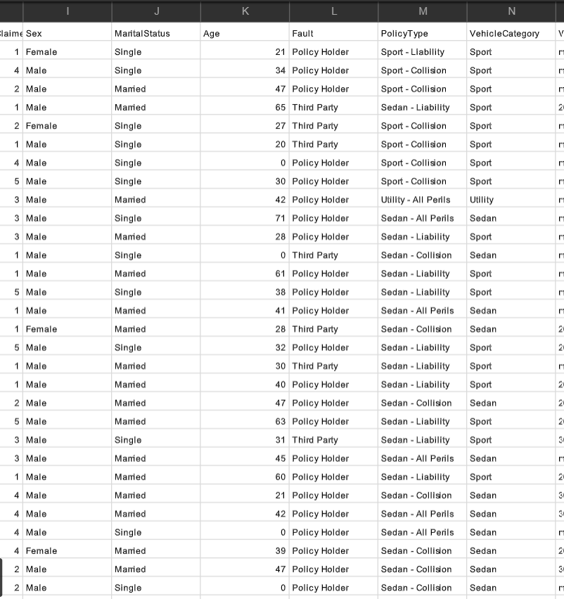

Dataset: https://drive.google.com/file/d/1q25one9oWQtkoMP5w8y_vcI5LENdlDoG/view?usp=sharing
All processes and more details:
Folder - Fraud Claim Detection

Slide 8
Business Model Canvas (BMC)
02

Slide 9
Key Partners Who are our key partners? Who are our key suppliers? Which key resources are we acquiring for them? |  | Key Activities What key activities do our value propositions require? Our distribution channels? Customer relationships? Revenue streams? | Value Proportions What value do we deliver to the customer? Which one of our customer’s problems are we helping to solve? What bundles of products and services are we offering to each customer segment? Which customer needs are we satisfying? |  | Customer Relationship What type of relationship does each of our customer segments expect us to establish and maintain with them? Which ones have we established? | Customer Segments For whom are we creating value? Who are our most important customers?
 |  | Key Resources What key resources do our value propositions require? |  |  | Channels Through which channels do our customer segments want to be reached? How are we reaching them now? How are our channels integrated? Which ones work best? Which ones are most cost-efficient? How are we integrating them with customer routines?
Cost Structure What are the most important costs inherent in our business model? Which key resources are the most expensive? Which key activities are the most expensive? |  |  |  | Revenue Streams For what value are our customers really willing to pay? For what do they currently pay? How are they currently paying? How would they prefer to pay? How much does each revenue stream contribute to overall revenues?

Slide 10
Key Partners
Key Partners Who are our key partners? Who are our key suppliers? Which key resources are we acquiring for them?
Partnerships with
Insurance and reinsurance companies to integrate the model into their existing systems
Providers to access additional data sources for training the model
Other companies in the insurance industry to expand the scope of the model and its predictions

Slide 11
Key Activities
Key Activities What key activities do our value propositions require? Our distribution channels? Customer relationships? Revenue streams?
Creating and maintaining the fraud detection model
Ongoing research and development to improve the model and stay ahead of the competition

Slide 12
Key Resources
Key Resources What key resources do our value propositions require?
Data scientists and engineers to develop and maintain the machine learning model
Data sources for training the model and validating its accuracy

Slide 13
Value Proportions
Value Proportions What value do we deliver to the customer? Which one of our customer’s problems are we helping to solve? What bundles of products and services are we offering to each customer segment? Which customer needs are we satisfying?
Reduce fraudulent claims in the insurance industry which can save time and money, including reducing premiums for customers
Provide more accurate risk assessments for reinsurance companies
Improve overall accuracy and efficiency of fraud detection in the industry

Slide 14
Customer Relationship
Customer Relationship What type of relationship does each of our customer segments expect us to establish and maintain with them? Which ones have we established? How are they integrated with the rest of our business model? How costly are they?
Build trust with their customers by ensuring that only legitimate claims are paid out
Build trust and credibility with insurance and reinsurance companies

Slide 15
Channels
Channels Through which channels do our customer segments want to be reached? How are we reaching them now? How are our channels integrated? Which ones work best? Which ones are most cost-efficient? How are we integrating them with customer routines?
Sales team that works directly with insurance and reinsurance companies to implement the model
Online platform for insurance companies to access the model and its predictions
Strategic partnerships with other companies in the insurance industry
The sales team that works directly with insurance and reinsurance companies to implement the model
Online platform for insurance companies to access the model and its predictions

Slide 16
Customer Segments
Customer Segments For whom are we creating value? Who are our most important customers?
Insurance companies that are at risk of fraudulent claims
Reinsurance companies that need to price risk accurately
Customers who may benefit from reduced premiums due to fewer fraudulent claims

Slide 17
Cost Structure
Cost Structure What are the most important costs inherent in our business model? Which key resources are the most expensive? Which key activities are the most expensive?
e.g.
Salaries and benefits for employees
Cloud infrastructure costs for hosting and the model and its data
Marketing and sales expenses
Research and development costs for ongoing improvements to the model

Slide 18
Revenue Streams
Revenue Streams For what value are our customers really willing to pay? For what do they currently pay? How are they currently paying? How would they prefer to pay? How much does each revenue stream contribute to overall revenues?
Subscription fees for insurance companies to access the model and its predictions
Revenue sharing with reinsurance companies based on the improved risk assessments
Consulting fees for additional services related to fraud detection

Slide 19
Business Model
03

Slide 20

Types of Business Models
Subscription model
Pay-per-use model
Licensing model
Consulting model
Value-added services model

Slide 21
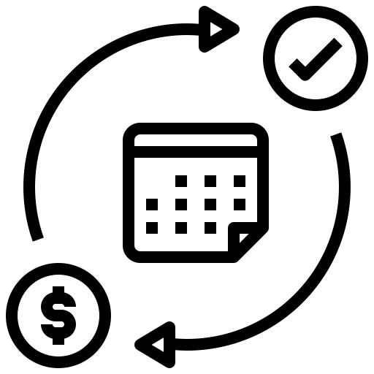
Subscription model
Under this model, you could charge insurance companies a recurring subscription fee to access your fraud detection model. This could be based on the number of claims processed each month or year or a flat rate based on the size of the insurance company

Slide 22

Pay-per-use model
Alternatively, you could charge insurance companies a fee for each claim that is processed using your model. This could be based on the complexity of the claim and the level of risk associated with it

Slide 23

Licensing model
Under a licensing model, you could license your fraud detection model to insurance companies for a one-time fee or an ongoing royalty. This would allow them to use the model in-house, rather than relying on a third-party service

Slide 24

Consulting model
Another option would be to offer consulting services to insurance companies , where you would work with them to develop a customized fraud detection solution based on their specific needs and data. This could be a one-time project or an ongoing engagement

Slide 25

Value-added services model
Finally, you could offer value-added services to insurance companies in addition to your fraud detection model, such as data analytics, risk assessment, or fraud prevention training, This could help differentiate your offering and provide additional revenue streams

Slide 26
04
Conclusion

Slide 27

Summary main points
Our solution which solved fraudulent claims is building the machine learning model for fraud detection that has many advantages such as reduced costs, more precise
I tell you in detail about the business model which makes you know how to apply our solution to create business value or decrease fraud risk

Slide 28
Thanks
If you have any questions
Don’t hesitate to contact me
Panupong Jindarat
Panupong.intern.work@gmail.com
088-894-6268

